Slide 1
Sentiment Analysis of Yelp Reviews with Spark ML and Spark Streaming
​
April 24th, 2023
Notes:
Thao

Slide 2
Objective and Process Overview
Objective: To predict Review Sentiment real-time using SparkML and Spark-Streaming on the Yelp Review dataset.
Data Cleaning
Feature Engineering
Predictive Modelling
Data Analysis
GCP Deployment
Spark Streaming
Prediction Engine
Sentiment Prediction

Slide 3
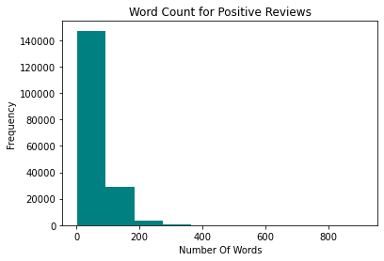
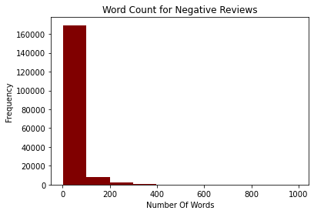
Word Count Frequency Analysis
The negative reviews are highly skewed as they contain < 100 words per review.
The positive reviews seem to have more content than their negative counterparts.

Slide 4
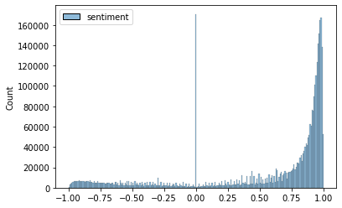
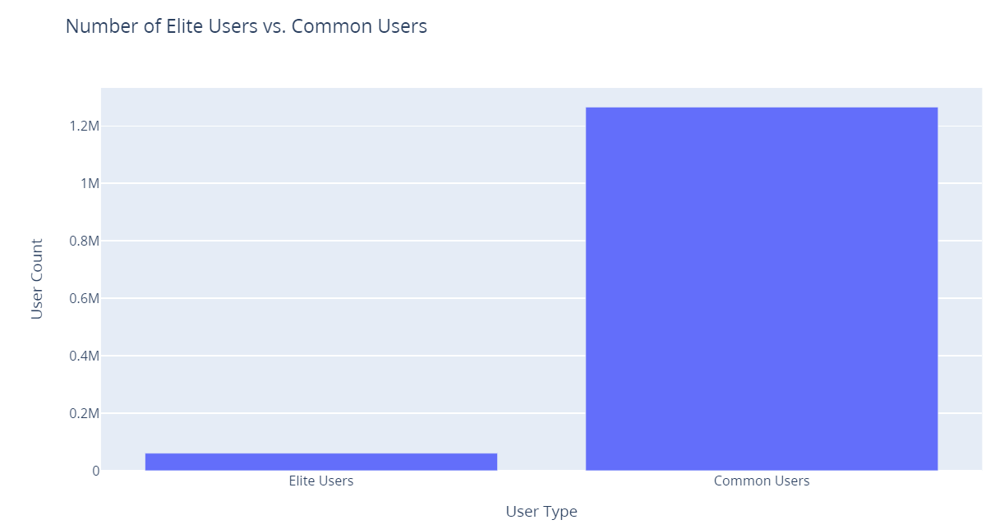
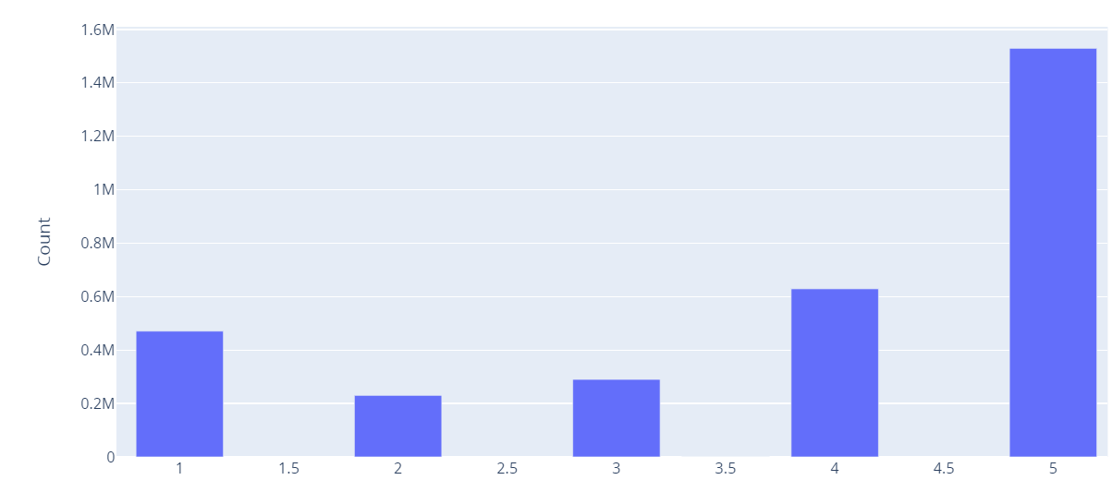
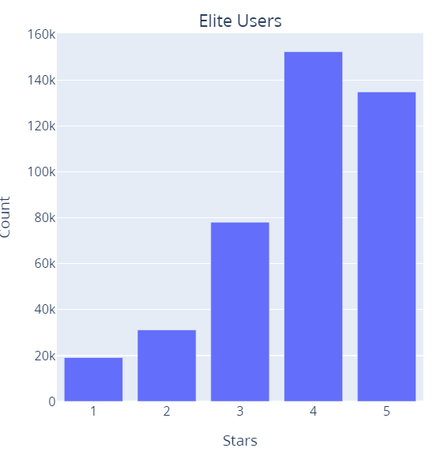
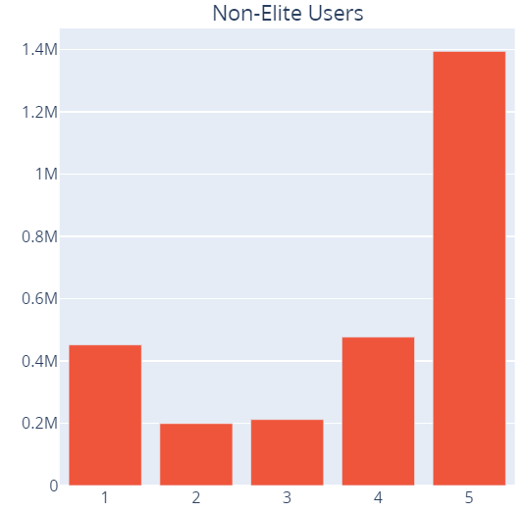
Yelp review – EDA
Positive in Nature
Elite users = 60818
Common users = 1265282

Slide 5
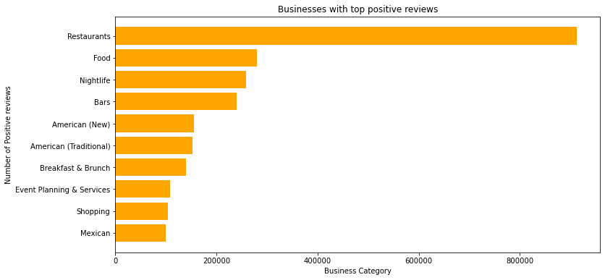
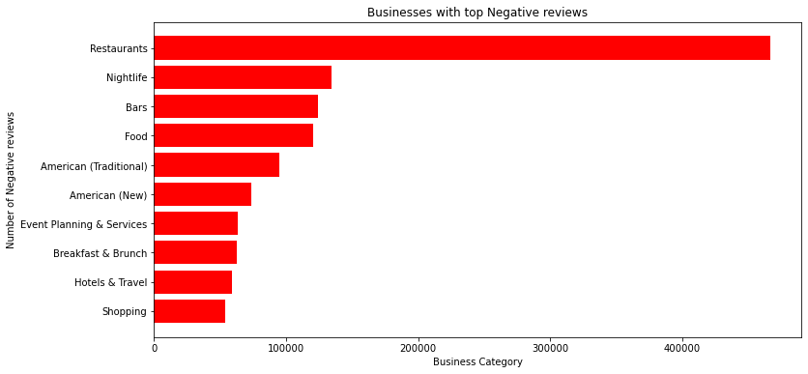
Businesses with Top Reviews
We can see that Restaurants generally have the highest number of reviews than other businesses.

Slide 6
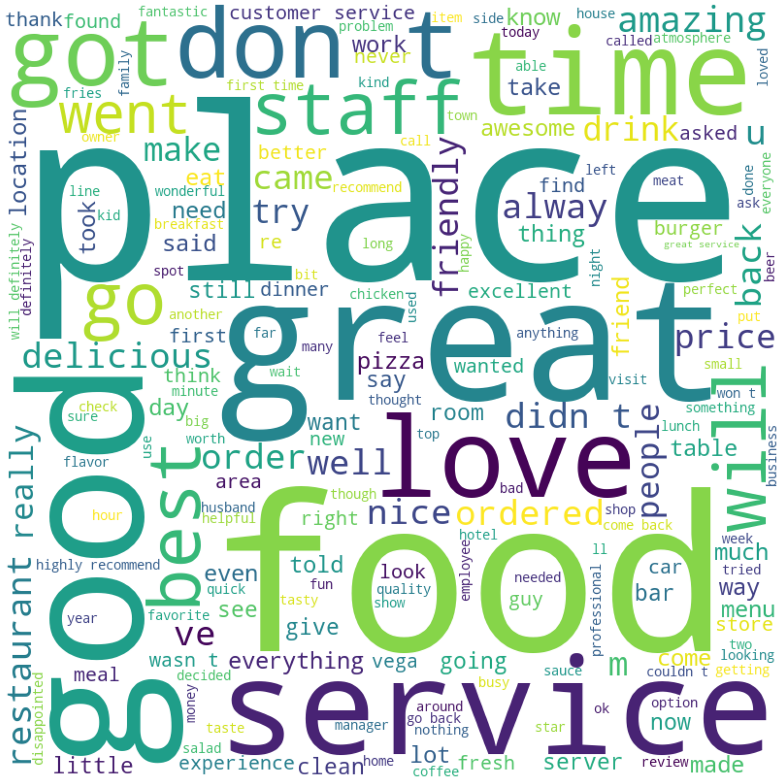

Word Cloud
Some Common words are place, great, good, food, service & so on

Slide 7
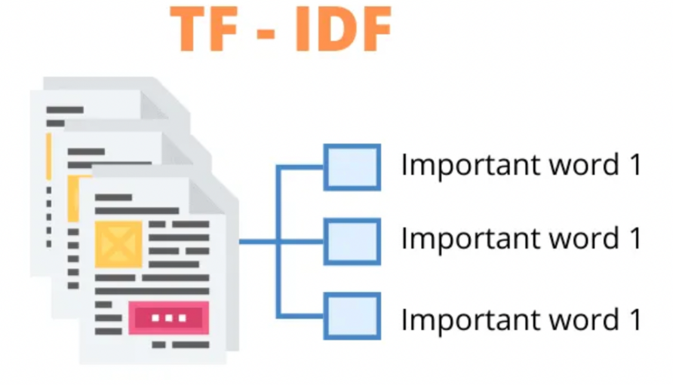
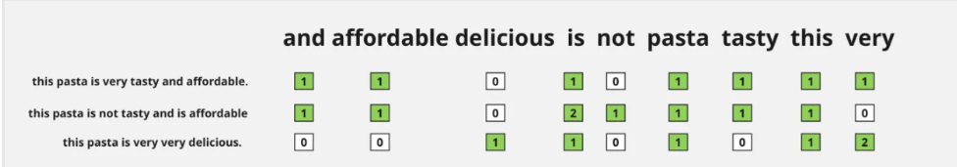
Sentimental Prediction using SparkML
Data Preprocessing
Build ML models in GCP using SparkML
Data Preprocessing
Vectorization
TF-IDF
Vectorization
TF-IDF
MODELS | F1 SCORE
Naïve Bayes | 87%
Logistic Regression | 90%
SVM | 88.9%
Notes:
We built a predictive model using Spark ML
We experimented with multiple models and these 3 model offered the best results
We have used Tokenization and tf-IDF approach to prepare the features

Slide 8
Spark Streaming Predictions
Model Objects saved in HDFS
SVM Model saved in HDFS
Tokenization, Vectorization, tf-IDF
Model Prediction
Streaming Data Input
Data Cleaning
Streaming Pipeline :
Conversion of Socket Stream Object to Spark Data frame
Preparation of New Test Data Frame to obtain required feature vectors
Print the model prediction of the new test data.

Slide 9
Thank You

